Slide 1
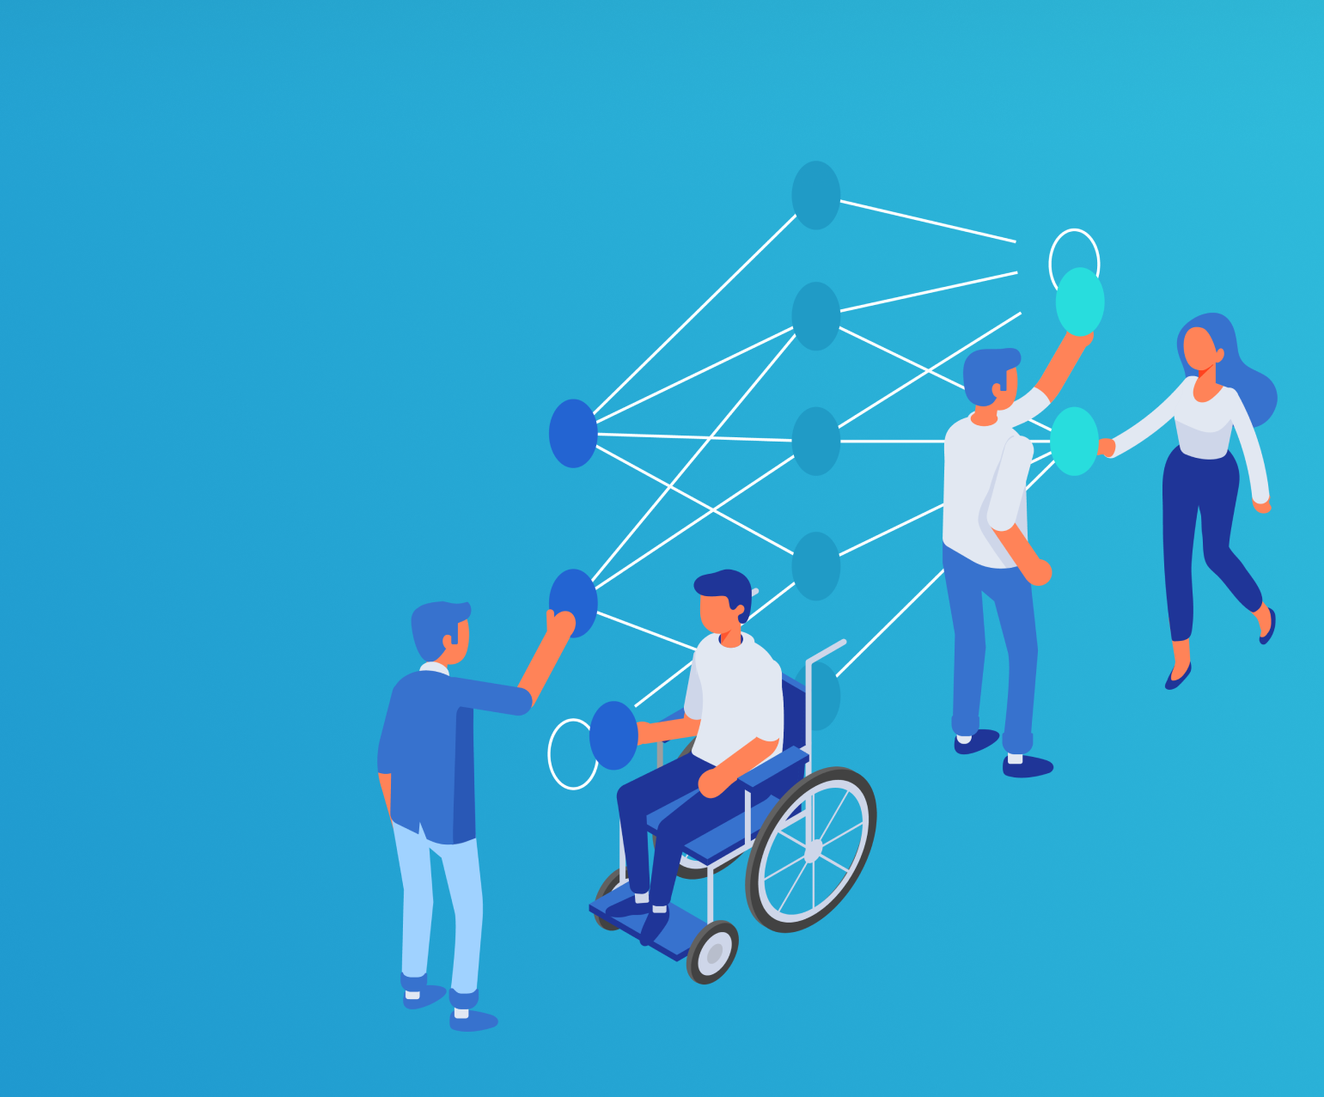
Responsible ML: Getting Started and Analyzing Your Models
Malika Malik
Data & AI Cloud Solution Architect

Slide 2
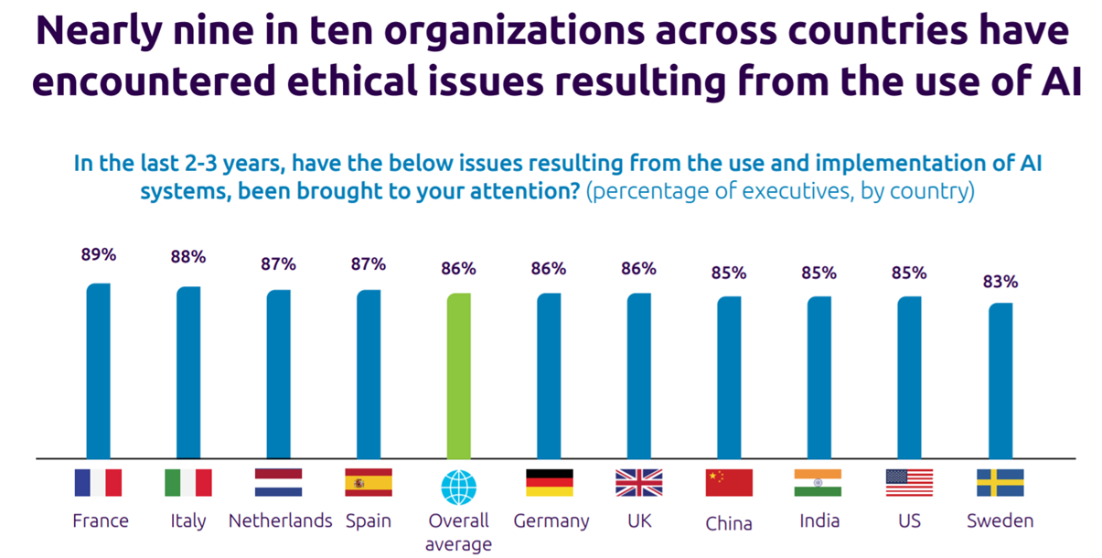
Why responsible AI?
7.5.19 Report from Capgemini

Slide 3
Tools and technologies
Notes:
© Microsoft Corporation. All rights reserved. MICROSOFT MAKES NO WARRANTIES, EXPRESS, IMPLIED OR STATUTORY, AS TO THE INFORMATION IN THIS PRESENTATION.

Slide 4






Tools and technologies
Understand
Protect
Control

Slide 5
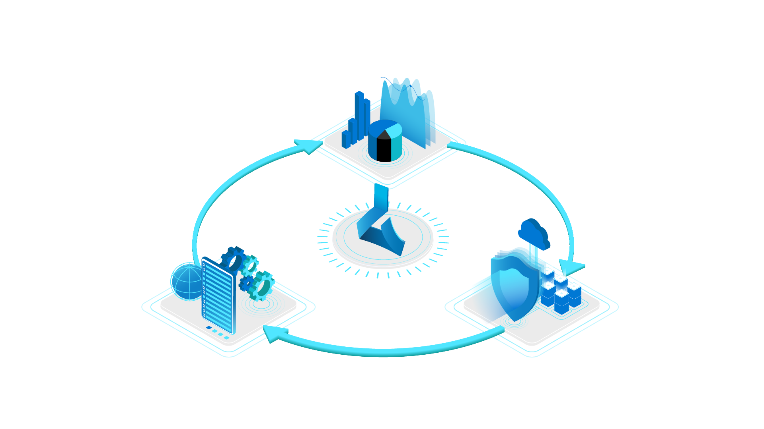
Understand
Interpretability
Fairness
Azure Machine Learning
Responsible ML
Control
Protect
Audit trail
Datasheets
Differential privacy
Confidential machine learning

Slide 6
Understand models and effects
Notes:
© Microsoft Corporation. All rights reserved. MICROSOFT MAKES NO WARRANTIES, EXPRESS, IMPLIED OR STATUTORY, AS TO THE INFORMATION IN THIS PRESENTATION.

Slide 7


Loan Application Decisions
Create a model for loan application acceptance
Azure Machine Learning
Is my model fair?
How does it decide who to accept or reject?
Notes:
© Microsoft Corporation. All rights reserved. MICROSOFT MAKES NO WARRANTIES, EXPRESS, IMPLIED OR STATUTORY, AS TO THE INFORMATION IN THIS PRESENTATION.

Slide 8
Fairness
Notes:
© Microsoft Corporation. All rights reserved. MICROSOFT MAKES NO WARRANTIES, EXPRESS, IMPLIED OR STATUTORY, AS TO THE INFORMATION IN THIS PRESENTATION.

Slide 9






Fairness in AI
There are many ways that an AI system can behave unfairly
A voice recognition system might fail to work as well for women as it does for men
A model for screening loan or job application might be much better at picking good candidates among white men than among other groups
Avoiding negative outcomes of AI systems for different groups of people

Slide 10
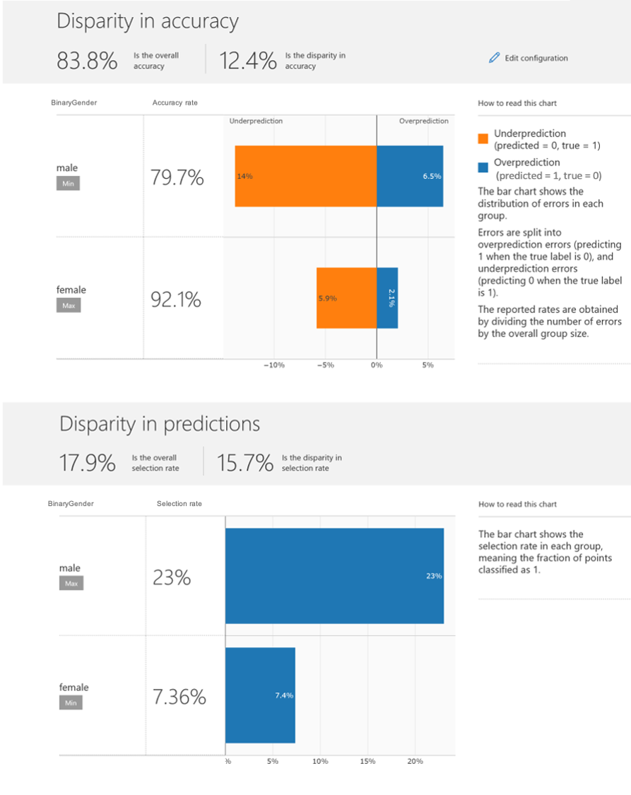


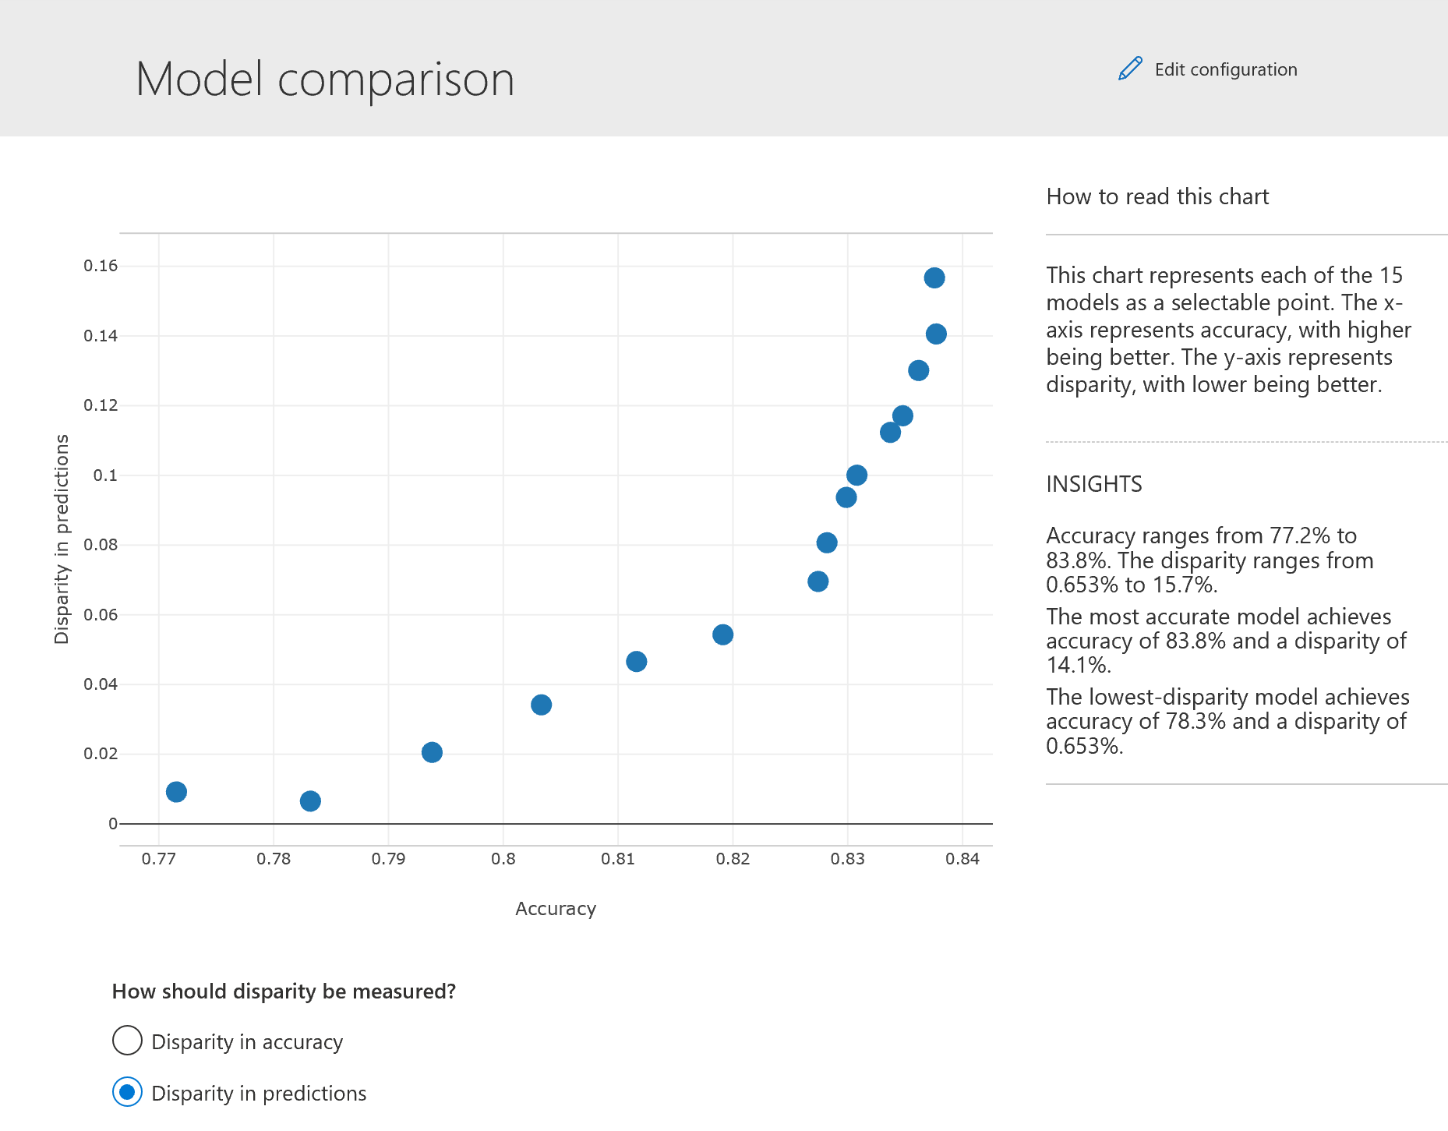
Assessing unfairness in your model
Fairness assessment:
Use common fairness metrics and an interactive dashboard to assess which groups of people may be negatively impacted
Model formats: Python models using scikit predict convention, Scikit, Tensorflow, Pytorch, Keras
Metrics: 15+ common group fairness metrics
Model types: Classification, Regression
Fairness mitigation:
Use state-of-the-art algorithms to mitigate unfairness in your classification and regression models
https://github.com/fairlearn/fairlearn

Slide 11


Fairness Assessment
Input Selections
Sensitive attribute
Performance metric
Assessment Results
Disparity in performance
Disparity in predictions

Slide 12
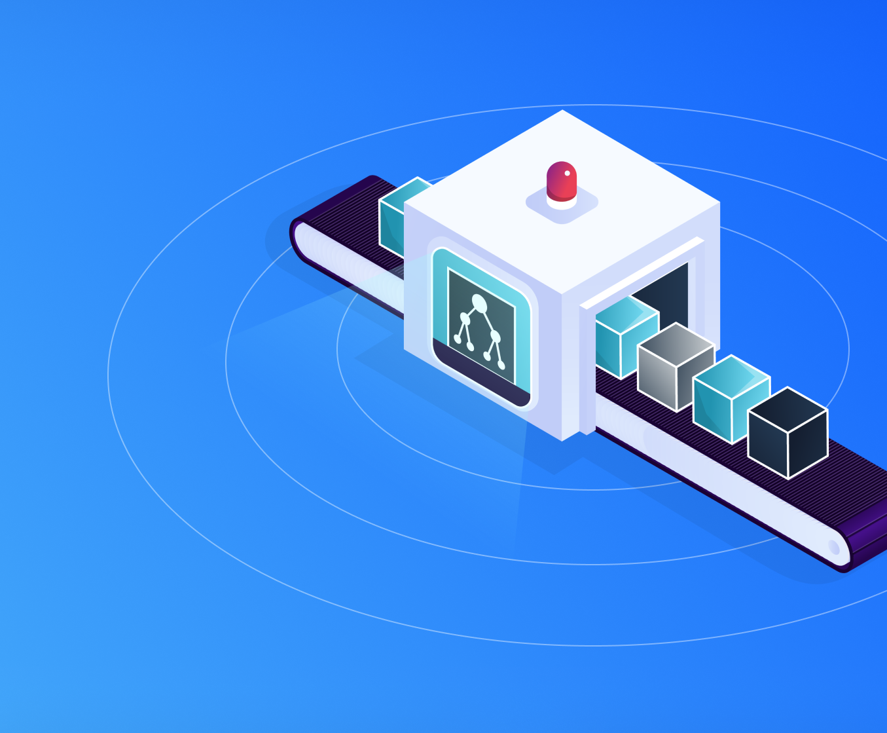
Interpretability
Notes:
© Microsoft Corporation. All rights reserved. MICROSOFT MAKES NO WARRANTIES, EXPRESS, IMPLIED OR STATUTORY, AS TO THE INFORMATION IN THIS PRESENTATION.

Slide 13
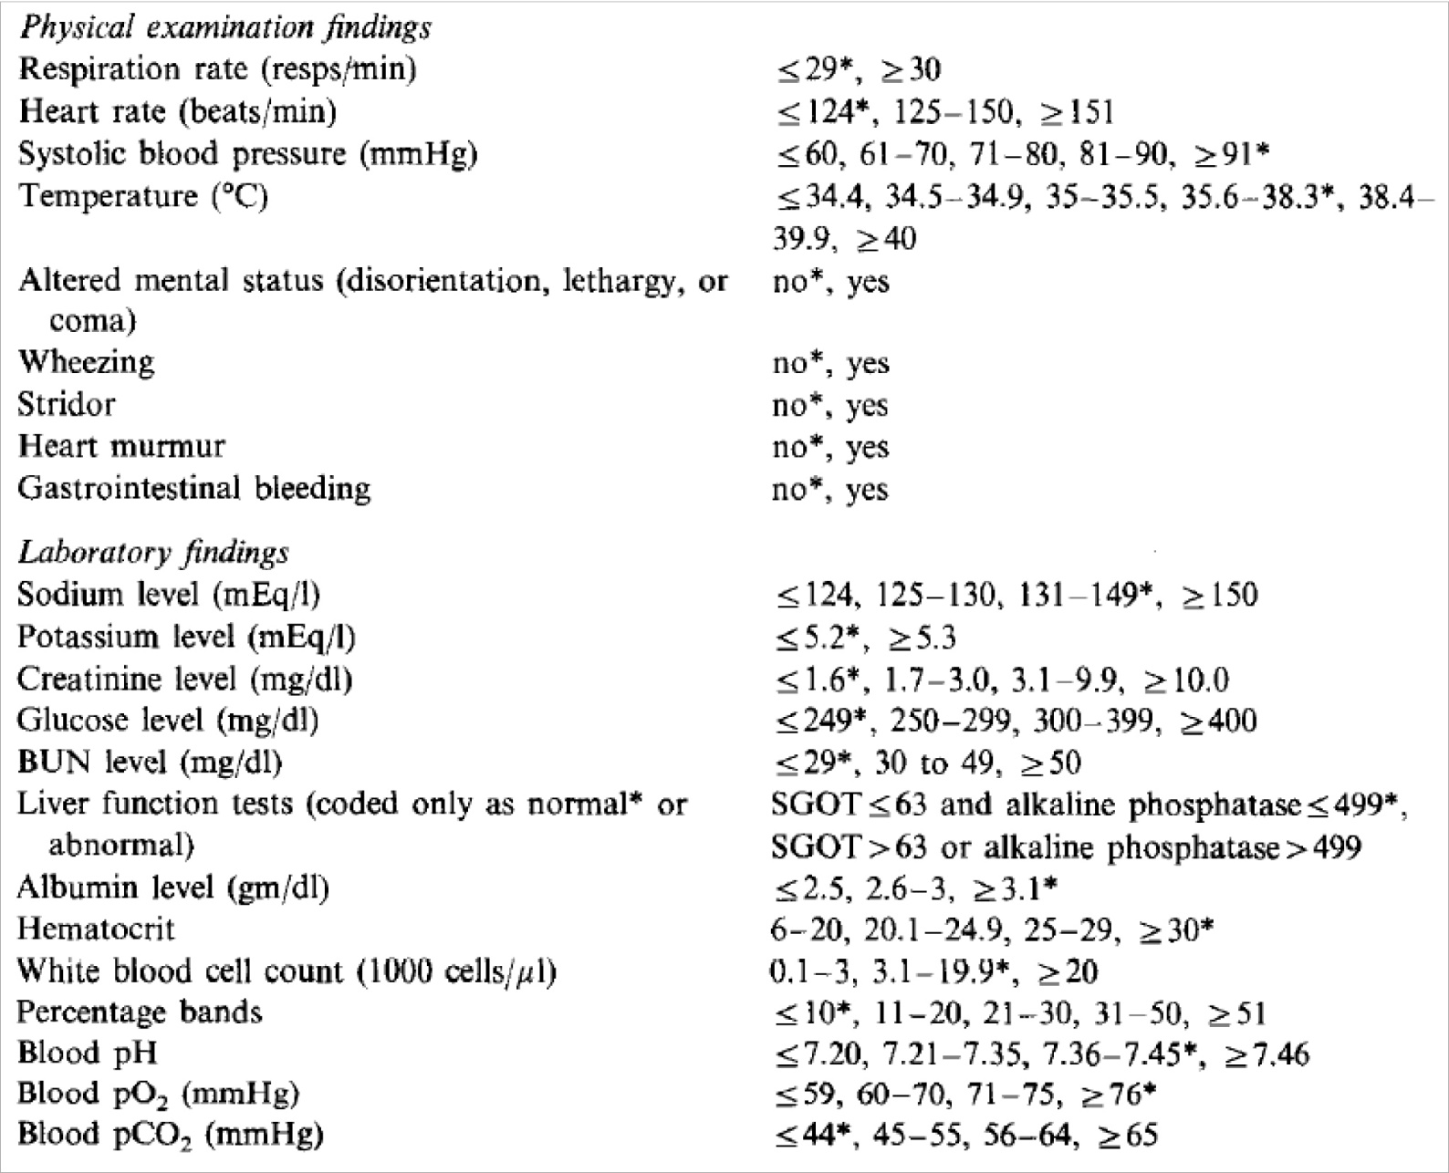
Pneumonia study, 1995
HasAsthma(x) => LowerRisk(x)
Intelligible Models for Healthcare: Predicting Pneumonia Risk and Hospital 30-Day Readmission
Caruana, et al, 2015

Slide 14
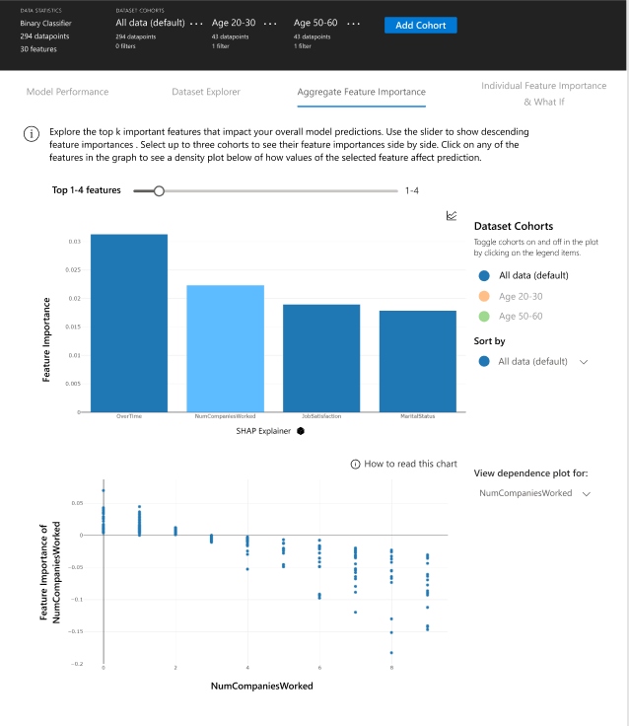





Understand and debug your model
Interpret
Glassbox and blackbox interpretability methods for tabular data
Blackbox models:
Model formats: Python models using scickit predict convention, Scikit, Tensorflow, Pytorch, Keras
Explainers: SHAP, LIME, Global Surrogate, Feature Permutation
Interpret-community
Additional interpretability techniques for tabular data
Glassbox Models:
Model types: Linear Models, Decision Trees, Decision Rules, Explainable Boosting Machines
Interpret-text
Interpretability methods for text data
AzurML-interpret
AzureML SDK wrapper for Interpret and Interpret-community
DiCE
Diverse Counterfactual Explanations
https://github.com/interpretml

Slide 15
Interpretability approaches
Glassbox models
Blackbox explanations

Slide 16
Models designed to be interpretable. Lossless explainability.
Glassbox models
Decision trees
Rule lists
Linear models
Explainable Boosting Machines
Fever?
Internal bleeding?
Stay home
Go to hospital
Stay home

Slide 17
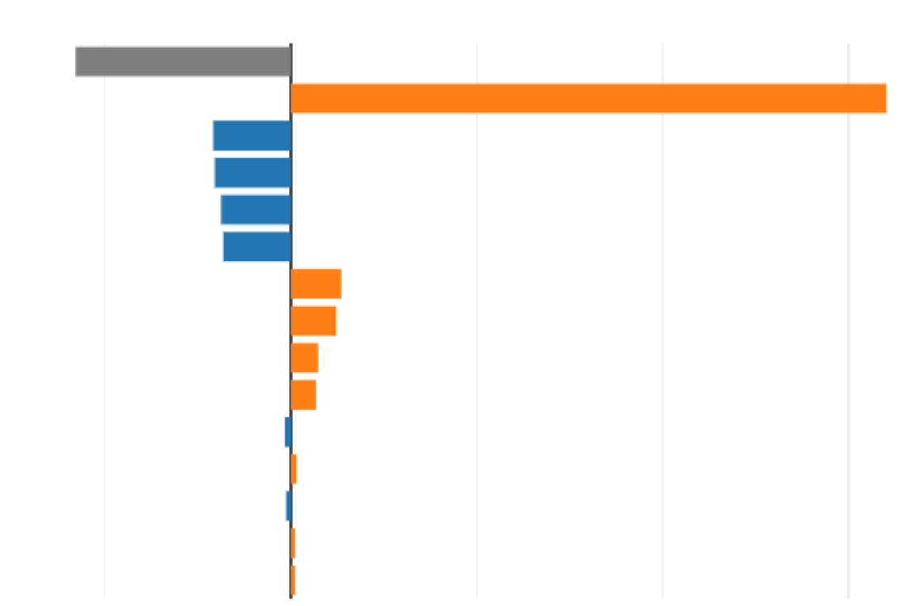
Explain any ML system. Approximate explainability.
Blackbox explanations
Perturb inputs
Shap
Lime
Partial dependence
Sensitivity analysis
Explanation
Model
Analyze

Slide 18


Fairness Mitigation
Fairness Criteria
Demographic Parity
Equalized Odds
Mitigation Algorithm
Postprocessing Method
Reduction Method

Slide 19
Responsible ML resources
Microsoft Responsible AI Resource Center
https://aka.ms/RAIresources
Azure Machine Learning
https://azure.microsoft.com/en-us/services/machine-learning/
https://docs.microsoft.com/en-us/azure/machine-learning/concept-responsible-ml
Responsible Innovation Toolkit
https://docs.microsoft.com/azure/architecture/guide/responsible-innovation
FairLearn
https://github.com/fairlearn
https://aka.ms//FairLearnWhitepaper
https://docs.microsoft.com/azure/machine-learning/concept-fairness-ml
InterpretML
https://github.com/interpretml
https://aka.ms//InterpretMLWhitepaper
https://docs.microsoft.com/azure/machine-learning/how-to-machine-learning-interpretability

Slide 20
Responsible ML resources
Microsoft Responsible AI Resource Center
https://aka.ms/RAIresources
Azure Machine Learning
https://azure.microsoft.com/en-us/services/machine-learning/
https://docs.microsoft.com/en-us/azure/machine-learning/concept-responsible-ml
FairLearn
https://github.com/fairlearn
https://aka.ms//FairLearnWhitepaper
https://docs.microsoft.com/azure/machine-learning/concept-fairness-ml
InterpretML
https://github.com/interpretml
https://aka.ms//InterpretMLWhitepaper
https://docs.microsoft.com/azure/machine-learning/how-to-machine-learning-interpretability
Responsible Innovation Toolkit
https://docs.microsoft.com/azure/architecture/guide/responsible-innovation
WhiteNoise
https://github.com/opendifferentialprivacy
https://docs.microsoft.com/azure/machine-learning/concept-differential-privacy
https://docs.microsoft.com/azure/machine-learning/how-to-differential-privacy
Https://aka.ms/WhiteNoiseWhitePaper
SEAL
https://github.com/Microsoft/SEAL
https://docs.microsoft.com/azure/machine-learning/how-to-homomorphic-encryption-seal
Datasheets
https://www.microsoft.com/en-us/research/publication/datasheets-for-datasets/
https://github.com/microsoft/MLOps/blob/master/pytorch_with_datasheet/model_with_datasheet.ipynb

